Slide 1
Car detection in snow
Group 16
Ayman abdul aziz, Talat can atilgan, jonathan chen, stefan Höglund, Srivikass jeyaprakash

Slide 2
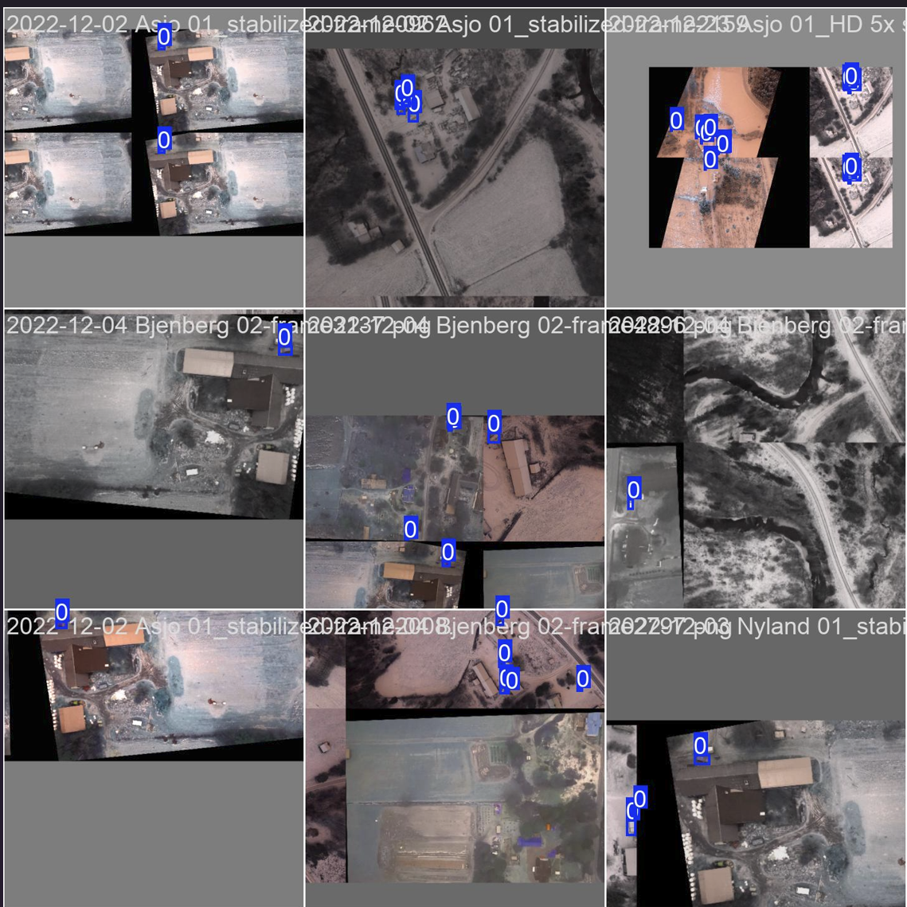
Dataset and training setup
Annotated snowy road scenes in YOLO format
Images resized to 640x640 for training
Training and validation after each epoch
Save best model
Training Parameters:
Epochs: 50
Batch size: 16
Workers: 4

Slide 3
Models Comparison
YOLOv9
Built by Ultralytics with focus on accuracy & speed
Introduces PGI (Programmable Gradient Info) and GELAN (Generalized Efficient Layer Aggregation Network).
YOLOv10
Released by Tsinghua University in 2024
YOLOv11
Latest Ultralytics model (May 2024)
Good balance of size, performance and generalization
End-to-end detection without Non-Max Suppression (NMS)
Highly efficient – fast inference but may result in lower accuracy
Enhance multi-task support (detection, segmentation, classification)
Strong architecture, but less stable on our snow dataset

Slide 4
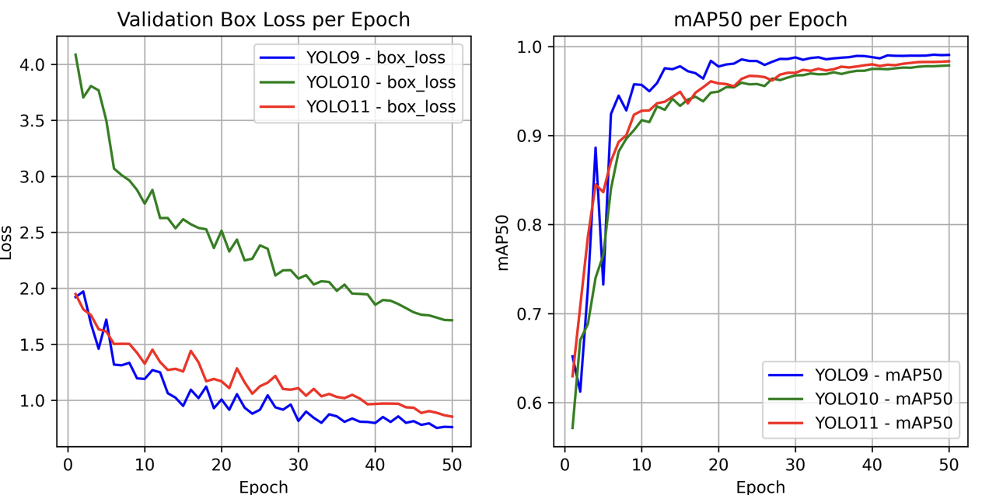
Models Comparison
Validation box loss
All models show steady loss reduction, indicating effective learning.
YOLOv9 converges the fastest with the lowest final loss → best localization accuracy
mAP50
YOLOv9 achieves a sharp rise early and maintains the highest accuracy.
YOLOv10 improves slowly
YOLOv11 is close to YOLOv9, but slightly lower.

Slide 5
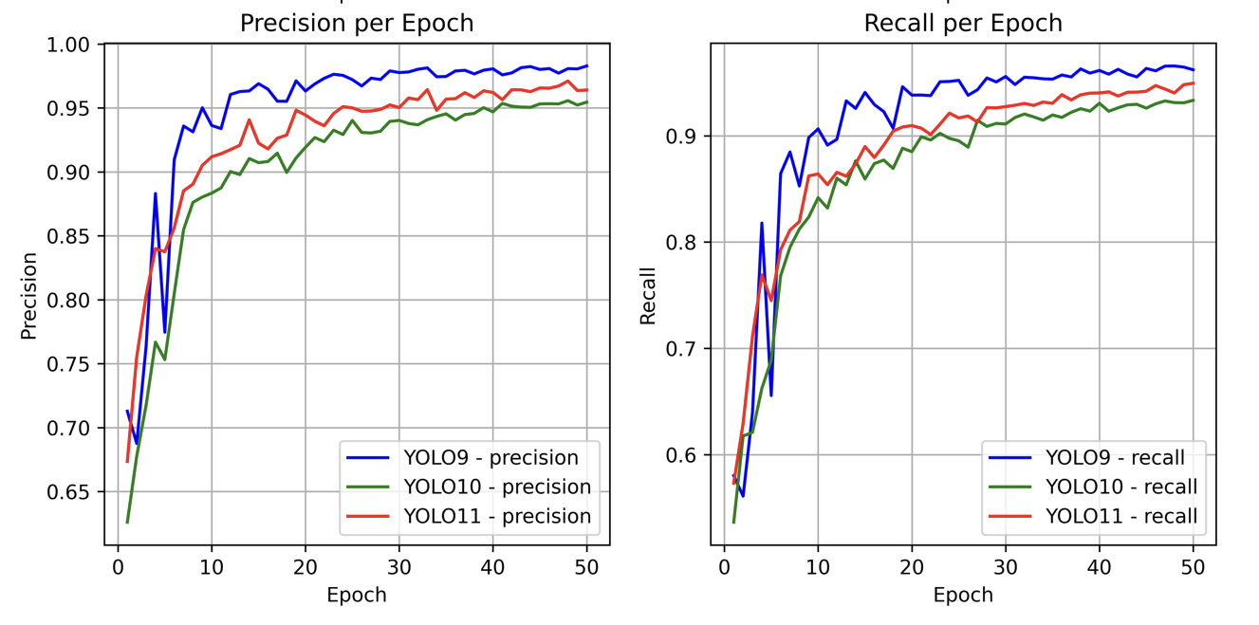
Models Comparison
Precision
YOLOv9 quickly reaches high precision and stays stable.
YOLOv10 ends lower;
YOLOv11 performs between v9 and v10.
Recall
YOLOv11 shows the highest final recall (fewer missed cars).
YOLOv9 is very close, with more stable recall performance.

Slide 6
Conclusion and future work
YOLOv9 is best suited for snow-based car detection
Achieved highest mAP50, precision and recall
Future work: Extend training dataset

Slide 7
THank you!

Slide 8
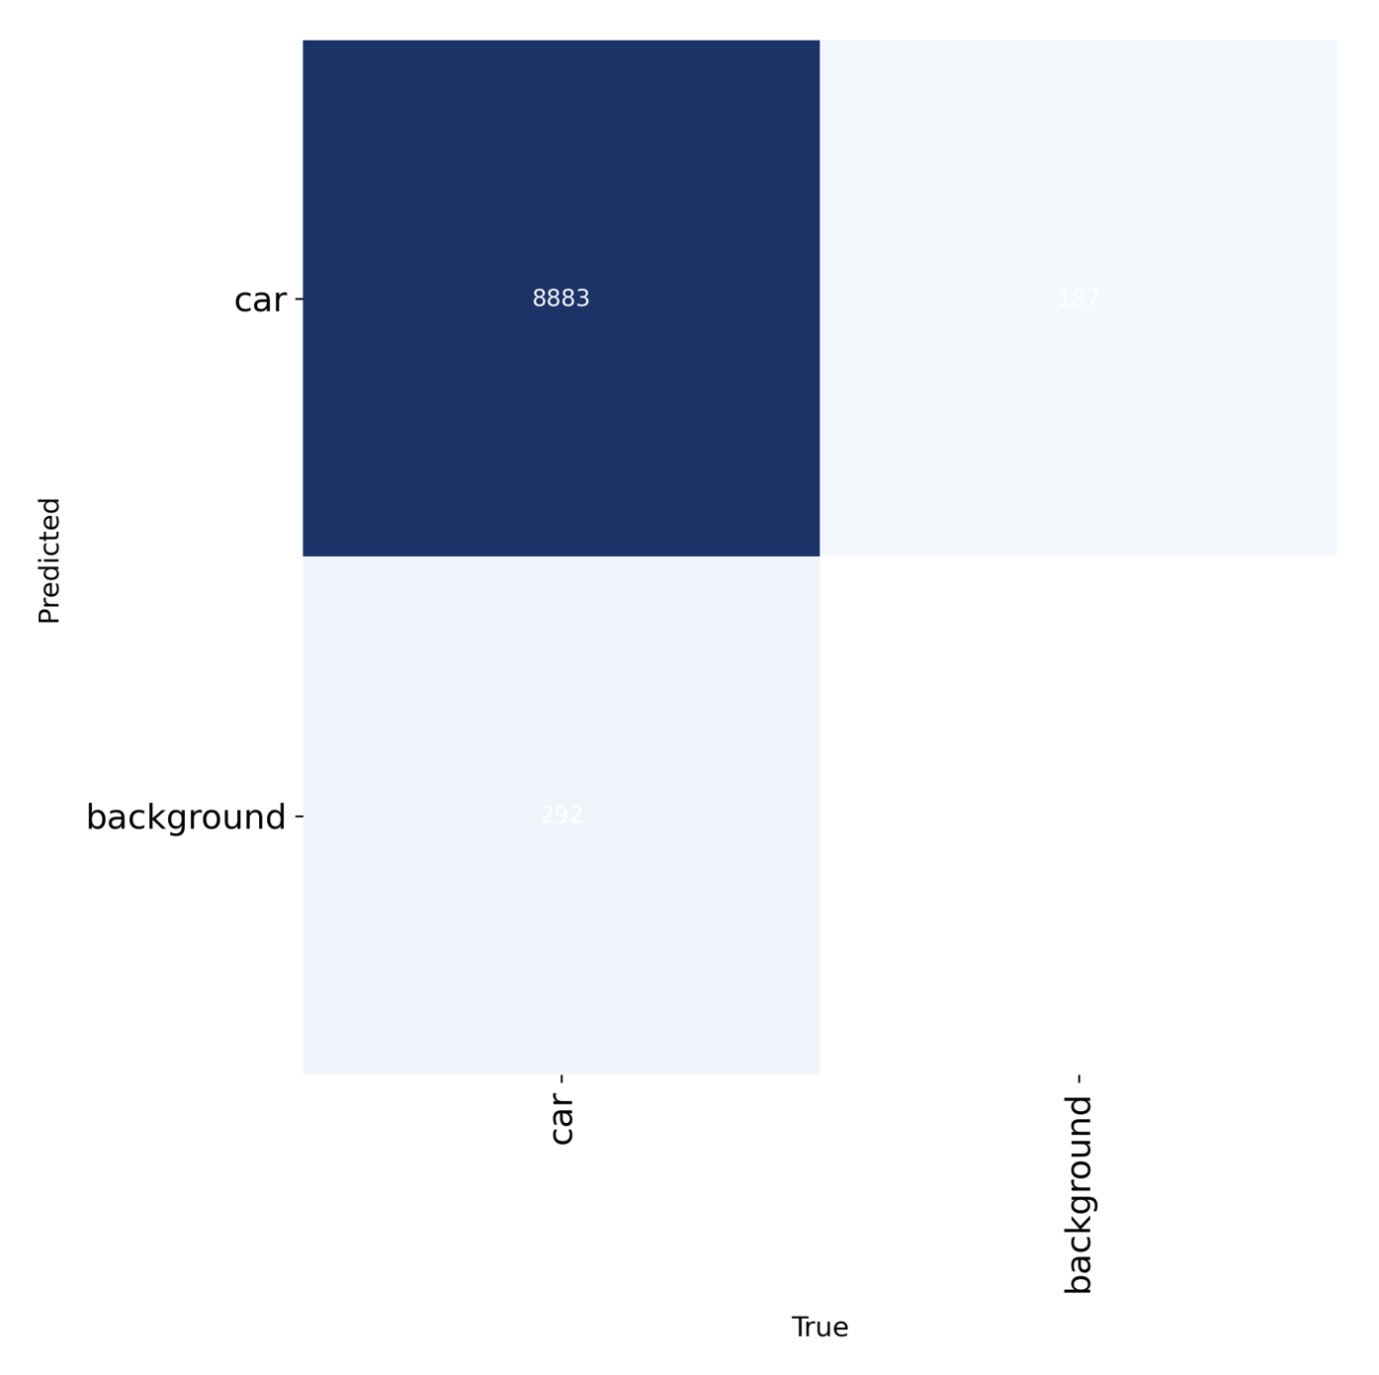
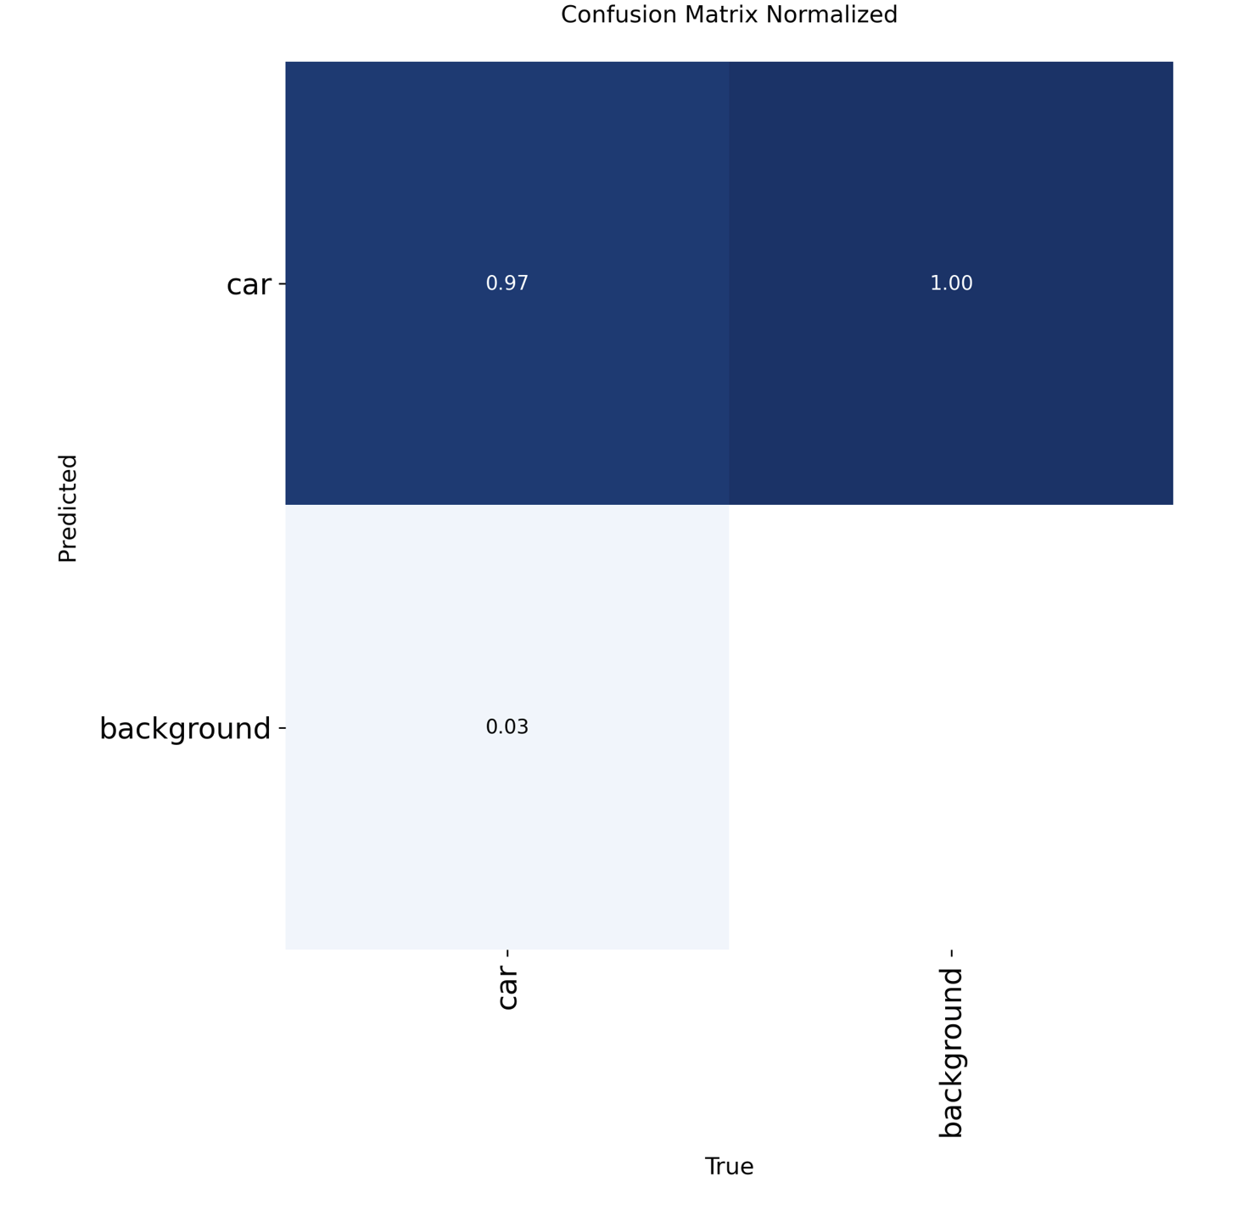
Confusion matrix – YOLOv9

Slide 9
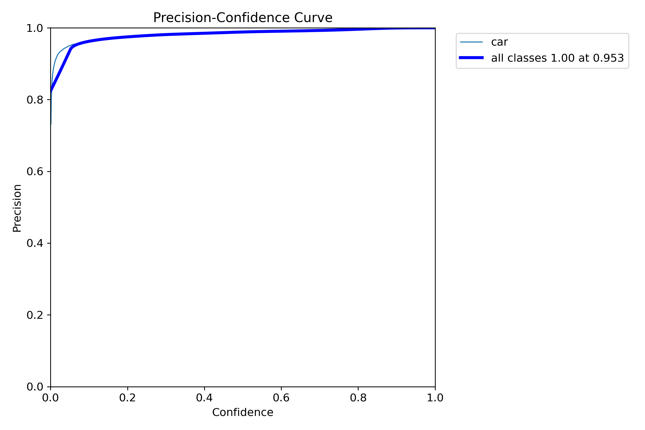
Precision – YOLOv9

Slide 10
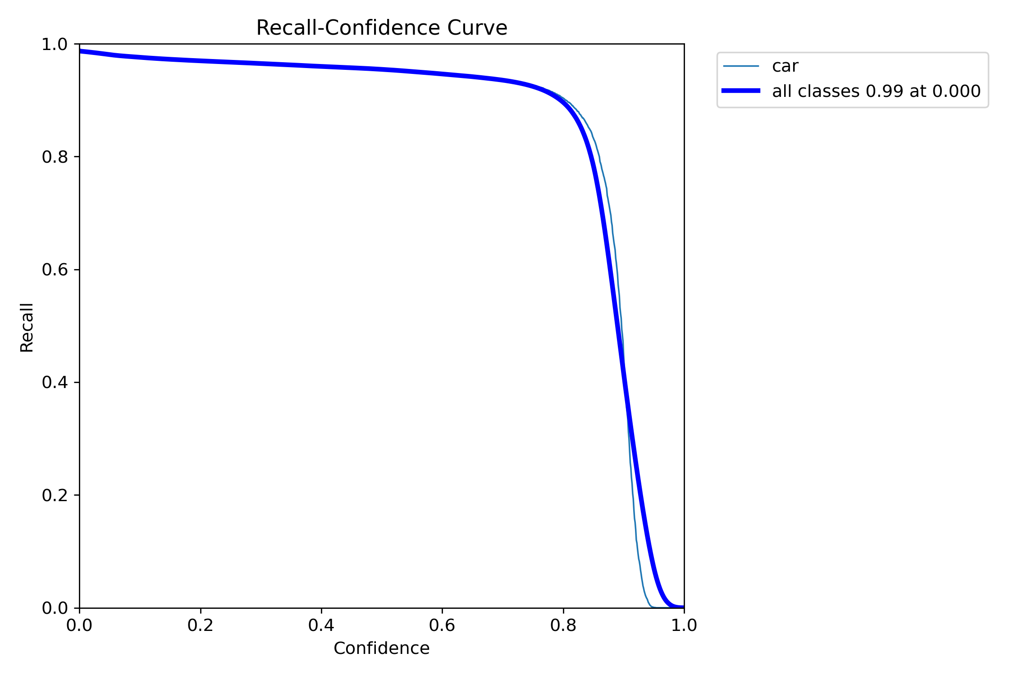
Recall – YOLOv9

Slide 11
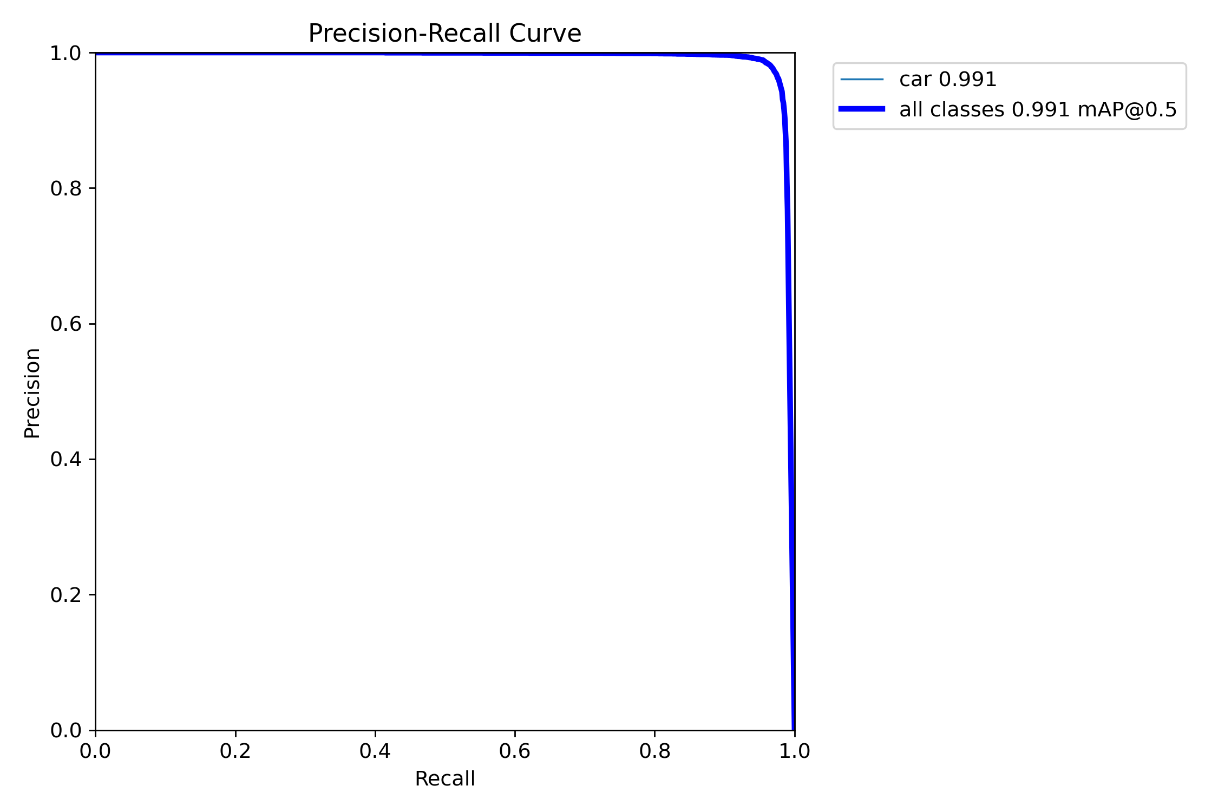
Precision-recall Curve-yolov9

Slide 12
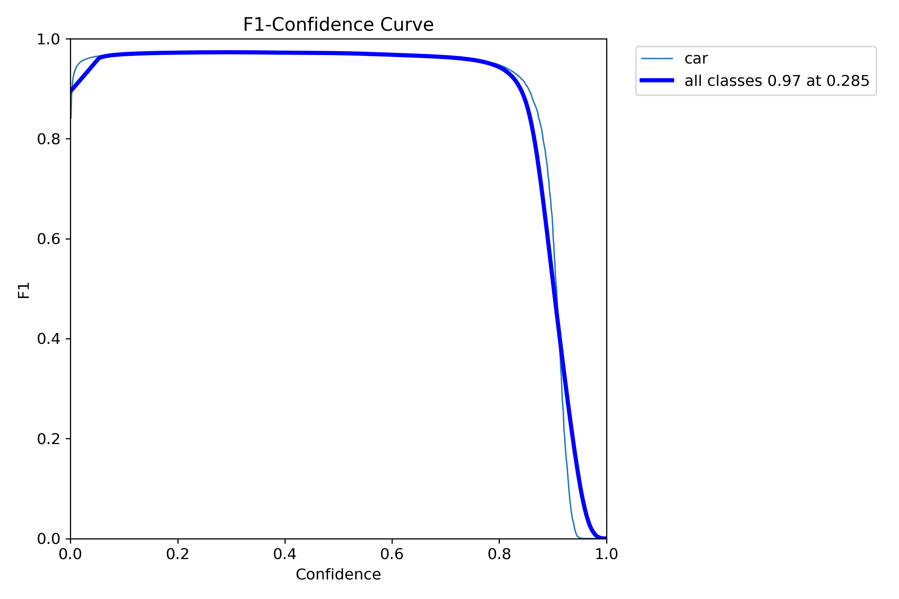
F1 Curve-yolov9

Slide 13
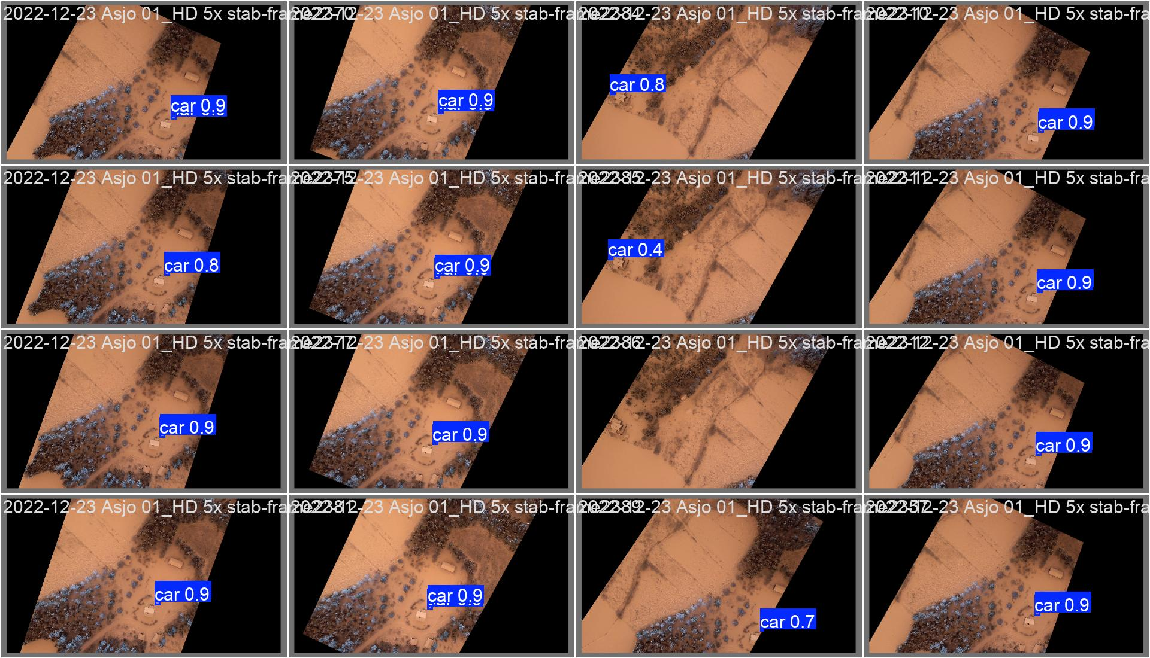
Yolov9 validation batch 0

Slide 14
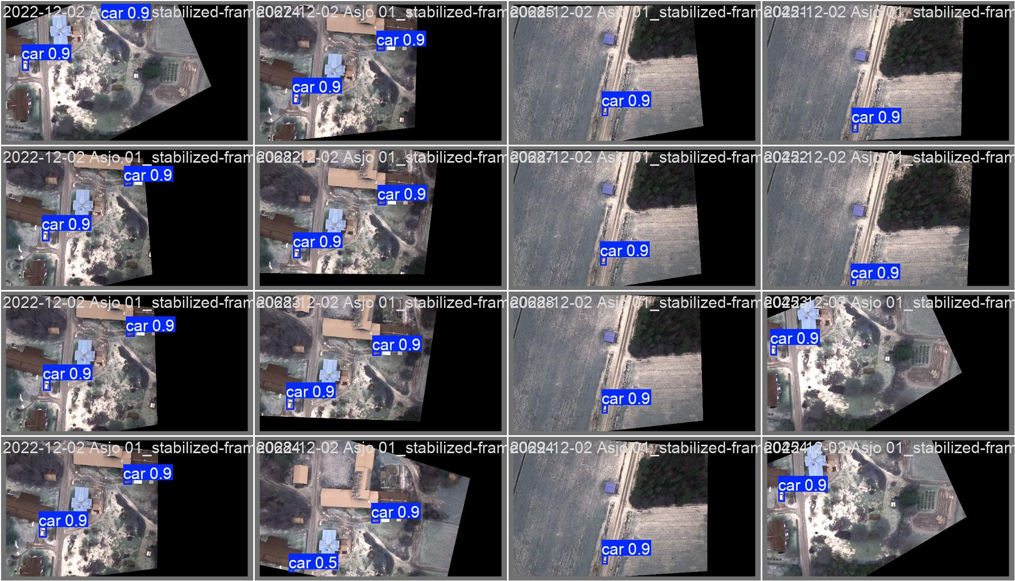
Yolov9 validation batch 1

Slide 15
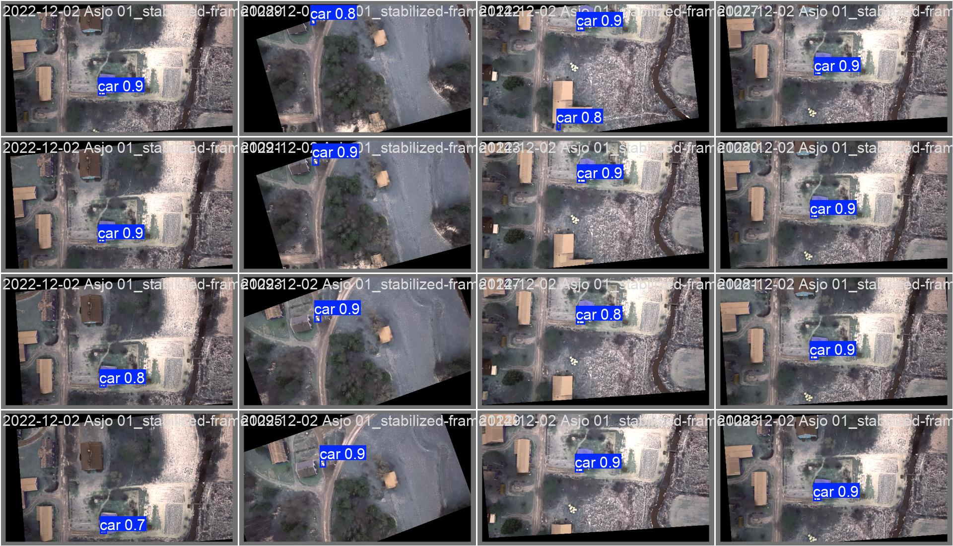
Yolov9 validation batch 2

